Slide 1
GI Bill® Comparison Tool
Screenshots
August 11, 2017

Slide 2
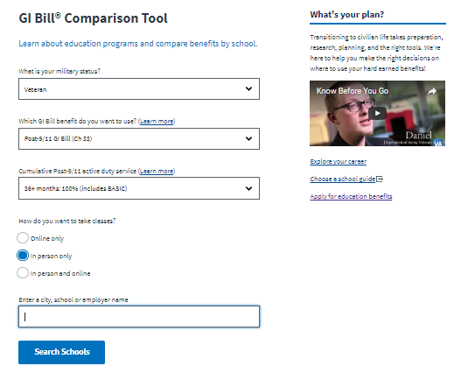
Home Page
Design modifications
Announcement Area
Additional features to be added:
Chapter Chooser
Enhanced Search (e.g., zip code, programs offered)
Welcome to the GI BILL Comparison Tool. The Comparison Tool is a Veteran Affairs online system that allows students and prospective beneficiaries to learn about education programs and compare estimated key measures of affordability and value on approved education benefit programs.
Chapter Chooser
Advanced Search
Notes:
Welcome to the GI BILL Comparison Tool
The Comparison Tool is a Veteran Affairs online system that allows students and prospective beneficiaries to learn about education programs and compare estimated key measures of affordability and value on approved education benefit programs.
How To
FAQ

Slide 3
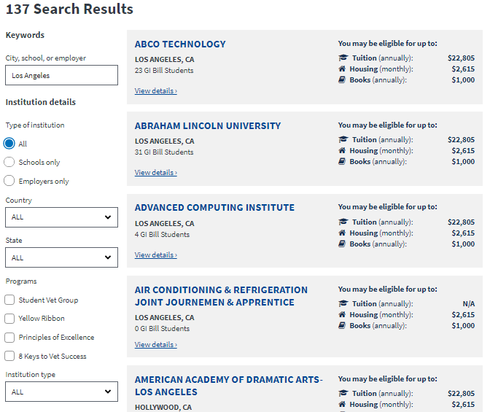
Search Results
Design modifications
Add school type to results (e.g., Public, Private, For Profit, OJT)
User should be able to collapse the search criteria
  Additional features to be added:
Enhanced Search (e.g., zip code, programs offered)
  Yelp-like rating system
Private School

Slide 4
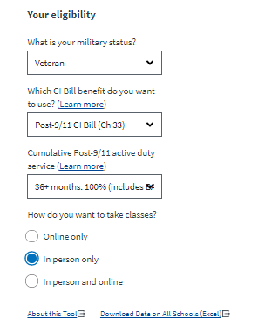
Search Results (Elig ??s)
Design modifications
When search criteria are collapsed these should be next to the school names
  Additional features to be added:
  None

Slide 5
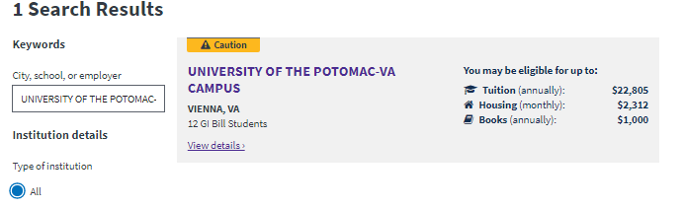
Search Results (Caution Flag)
Design modifications
Make caution flag more comprehensible and actionable
  Additional features to be added:
  None

Slide 6



School Profile Page (Header)
Design modifications
Move city right below school name (~search results)
Make # of GI Bill students larger
Remove http://www from website link
Align design w/ College Scorecard or move data to “add’l sch’l info”
  Locale
  Size
  Program (4 year)
  Additional features to be added:
  Yelp-like rating system
ucla.edu

Slide 7
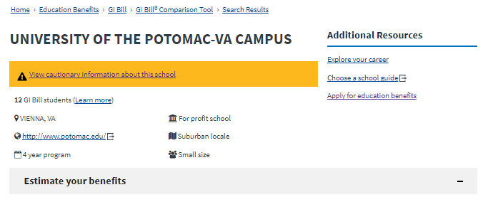
School Profile Page (Caution Flag)
Design modifications
Make caution flag more comprehensible and actionable
  Additional features to be added:
  None

Slide 8
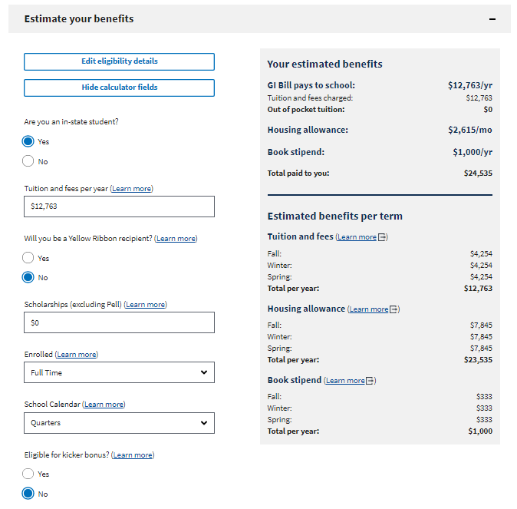
School Profile Page (Calculator)
Design modifications
Consider having estimated benefits across the top
Consider collapsing the calculator questions
Total GI Bill benefits paid should be displayed somewhere
Benefits by term should be grouped by term and not benefit
  Additional features to be added:

Slide 9
School Profile Page (Calculator)
Your estimated benefits
GI Bill pays to school: $12,763/yr
Tuition and fees charged: $12,763/yr
Out of pocket tuition: $0
Housing allowance: $2,615/mo
Book stipend: $1,000/yr
Total paid to you: $24,535/yr
Total GI Bill Benefits $37,298/yr
------
Estimated benefits per term
Fall
Tuition Fees $4,254
Housing allowance $7,645
Book Stipend $333
Total Fall: $12,232
Design modifications
Consider having estimated benefits across the top
Consider collapsing the calculator questions
Total GI Bill benefits paid should be displayed somewhere
Benefits by term should be grouped by term and not benefit
  Additional features to be added:

Slide 10
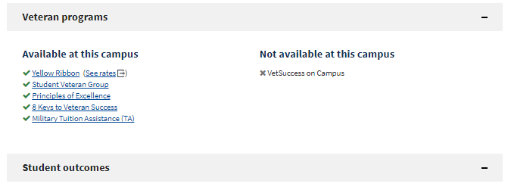
School Profile Page (Vet Prgms)
Design modifications
VSOC learn more link
  Additional features to be added:
  Show school’s Yellow Ribbon rates

Slide 11
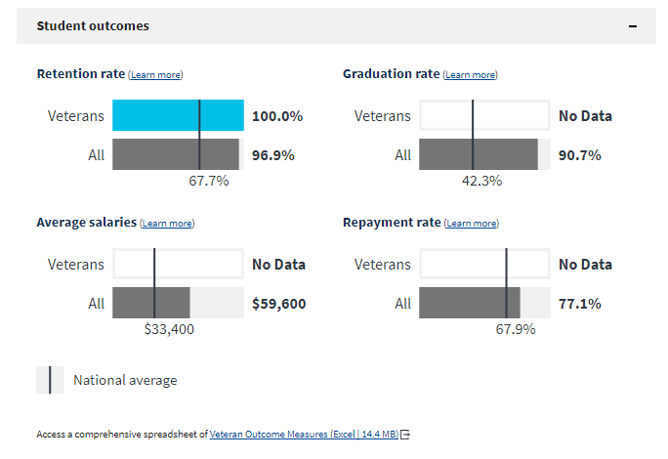
School Profile Page (Outcomes)
Design modifications
Color code outcomes that exceed or fall below the national average
Replace outcome spreadsheet link
  Additional features to be added:
  Toggle between outcomes for different cohorts (e.g., full-time vs part-time; veterans vs spouse vs dependent)
  Historical outcome measures

Slide 12
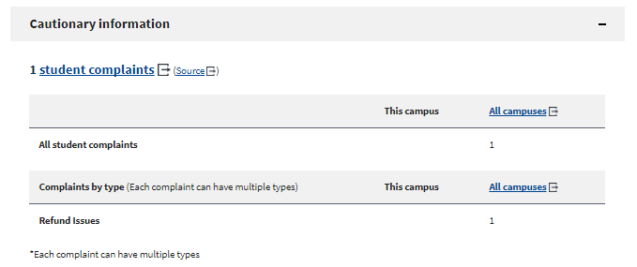
School Profile Page (Cautionary)
Design modifications
  Additional features to be added:

Slide 13
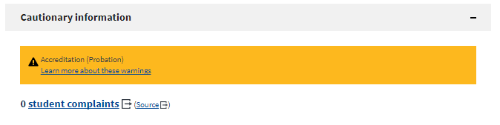
School Profile Page (Caution Flag)
Design modifications
Make caution flag more comprehensible and actionable
  Additional features to be added:

Slide 14
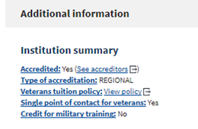

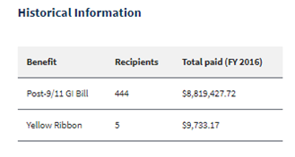
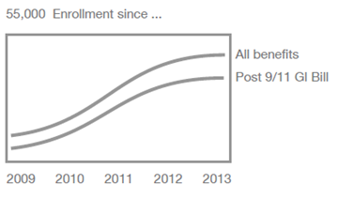
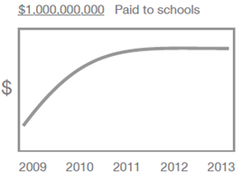
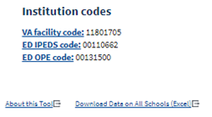
School Profile Page (Add’l Info)
Design modifications
Promote type of accreditation
  Additional features to be added:
  Historical information show enrollment & $$ spent over time (e.g., graph)
  School certifying official (SCO) information
  Programs offered
  Other school profile data (e.g., priority enrollment for veterans)
Priority enrollment for veterans: Yes
School Certifying Officials
John Doe 202-555-1234
Jane Doe 202-555-4321
Most popular programs
Business administration
Nursing
See all programs offered
Yellow Ribbon Information
XXXX
XXXX

Slide 15
